Slide 1

Personal Development Award Key Stage 3
Ripon Grammar School
Year 7

Slide 2


Slide 3

Year 7 The White Rose is an ancient symbol of purity and has been adopted as the emblem of Yorkshire since the 14th century. Ripon, the oldest city in England, is home to Ripon Cathedral, where the Saxon crypt stands as the oldest surviving structure of any cathedral in England. This crypt was founded in 672 by St. Wilfrid and remains a testament to the region's rich history. The Saxon Award offers students opportunities to engage in challenging and enriching experiences that foster both personal and academic development. By participating in this award, students can deepen their understanding of history, culture, and community, while developing skills that will serve them throughout their lives.

Slide 4

Year 8

Slide 5

Year 9

Slide 6
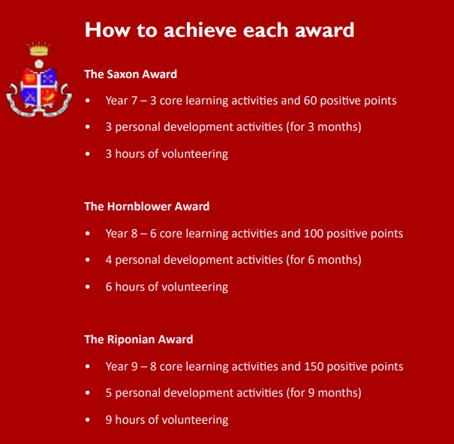

Slide 7
RGS Core Values
Respect
Integrity: We want our students to be leaders, guided by a core set of beliefs who know what is the right thing to do
Inclusivity: We want a community which celebrated diversity and equality
Growth
Curiosity: We recognise that a love of learning springs from curiosity to ask questions and think creatively
Aspiration: We want our students to pursue their passions in life
Support
Empathy: We recognise that care for others is based on an ability to connect with each other
Kindness: We want our students to value and support each other in a spirit of mutual cooperation and friendship

Slide 8
Inclusive
Each young person is recognised as a valued member of our diverse community and deserves equal opportunity to thrive.
Through our award, we support every individual to develop the knowledge, skills, and personal qualities—such as resilience, confidence, and social awareness—needed to flourish and succeed.

Slide 9
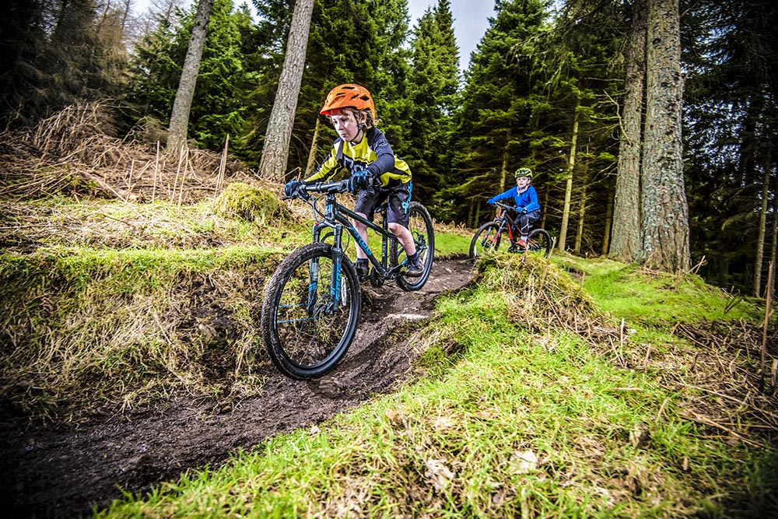
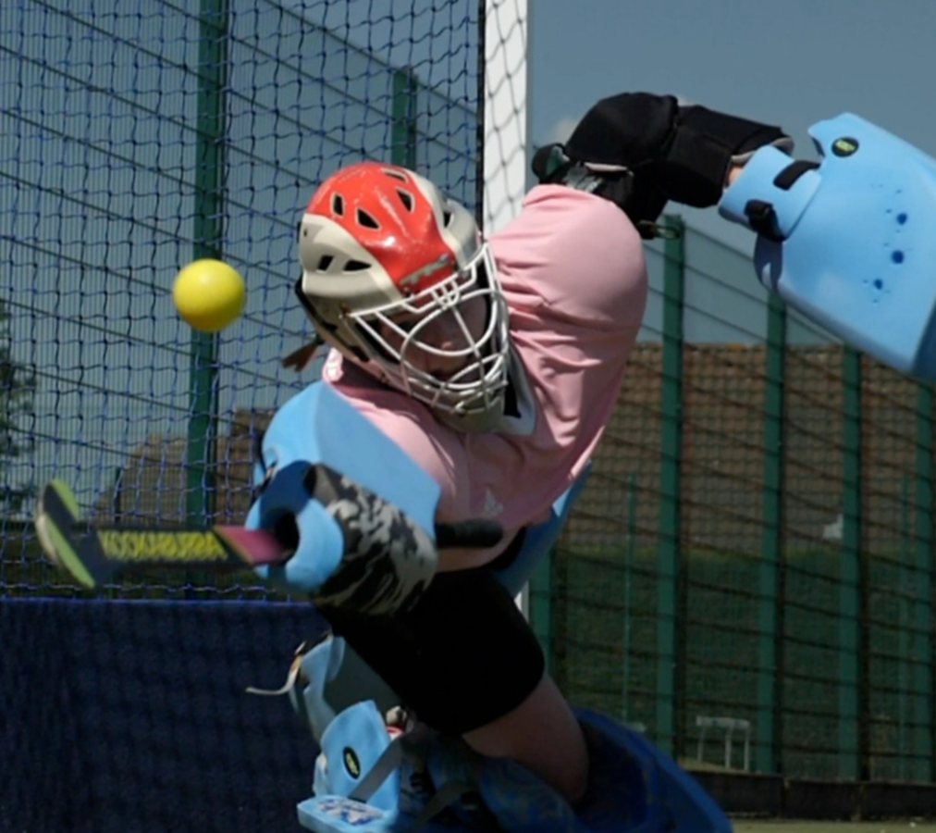
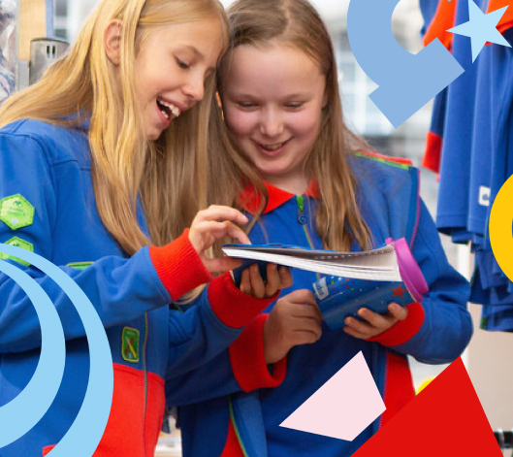
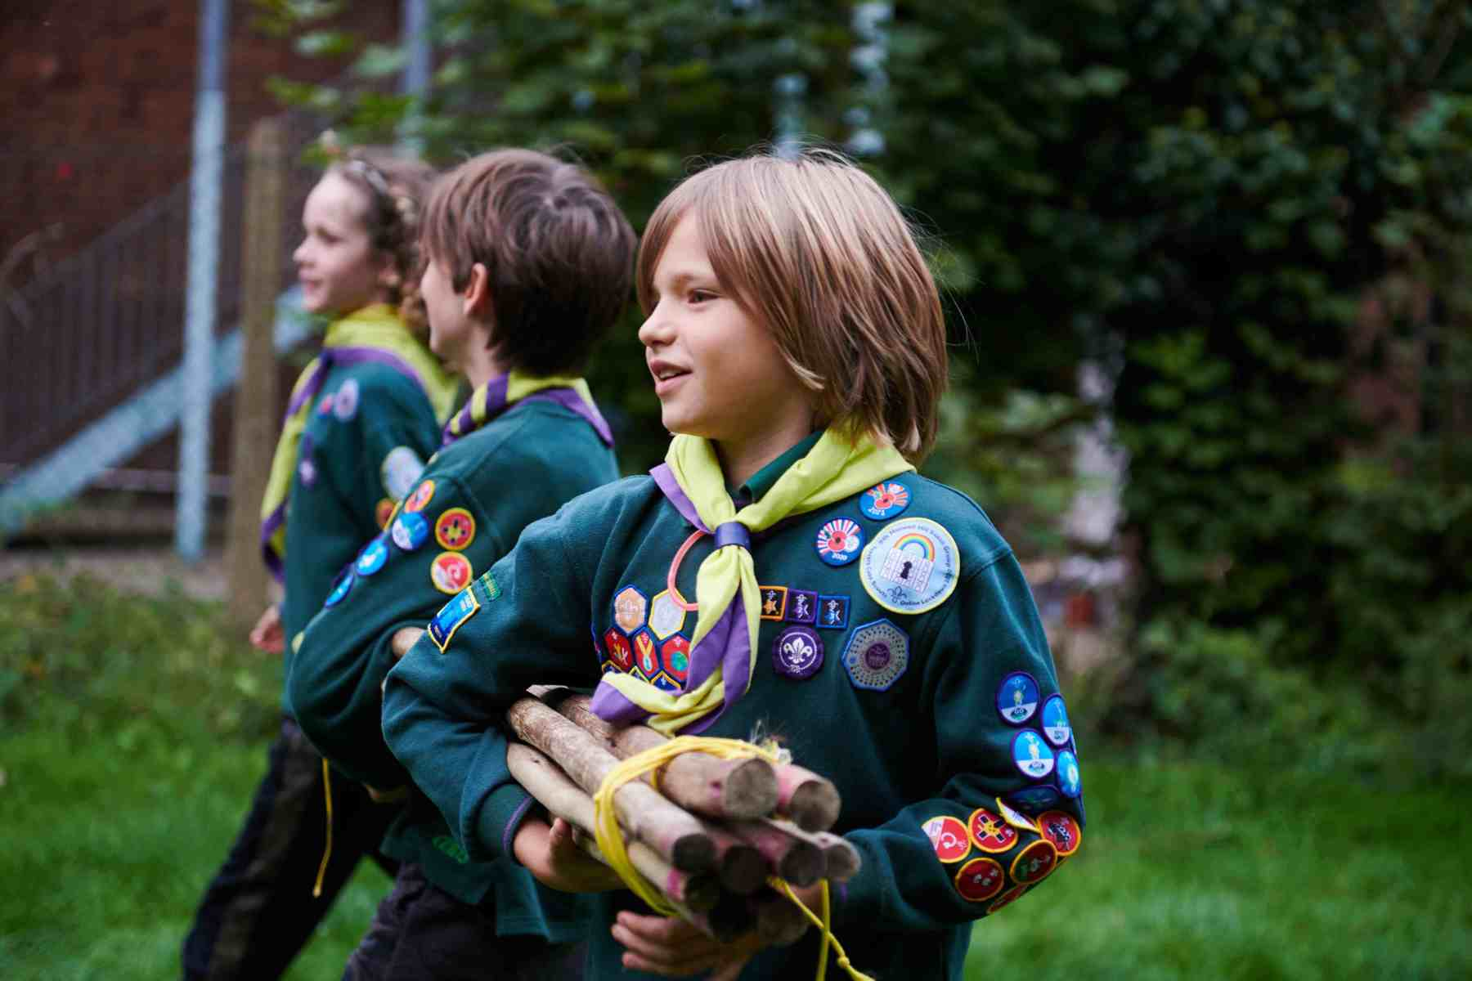
Opportunities both inside and outside school

Slide 10
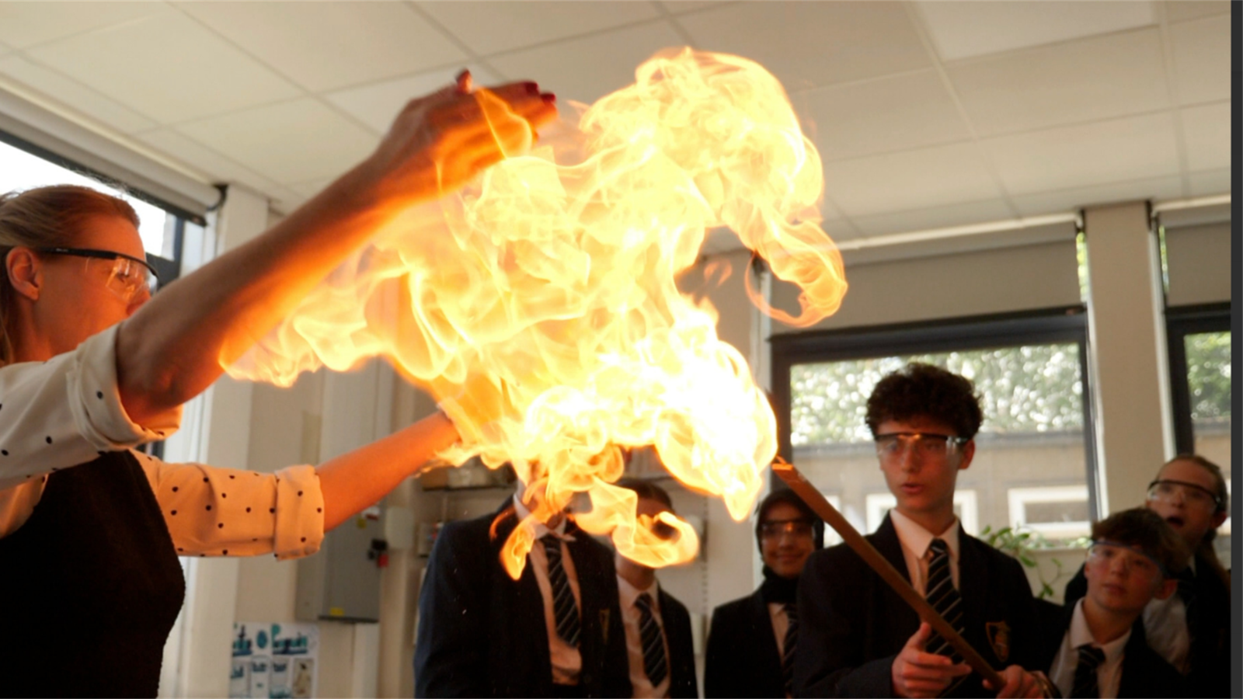
How to achieve the award

Slide 11
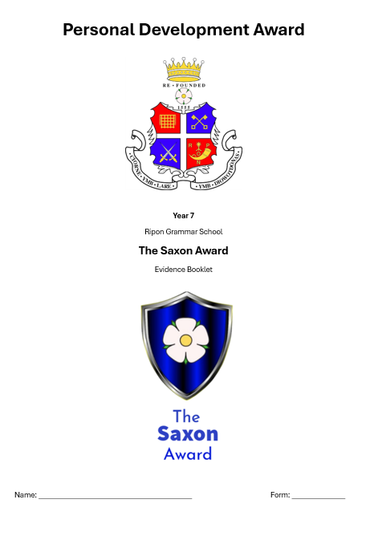
Evidence Booklet

Slide 12

Core Learning
Complete 3 core learning activities set by departments
Gain 60 positive points across the year from your teachers

Slide 13
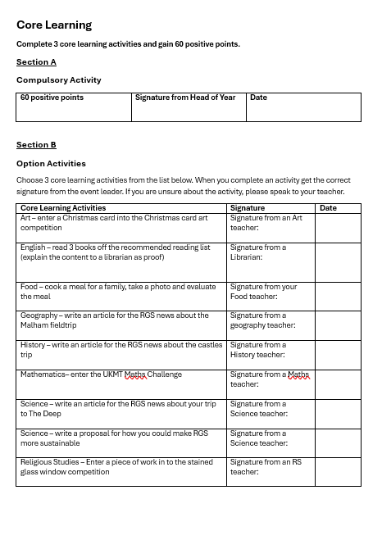

Slide 14
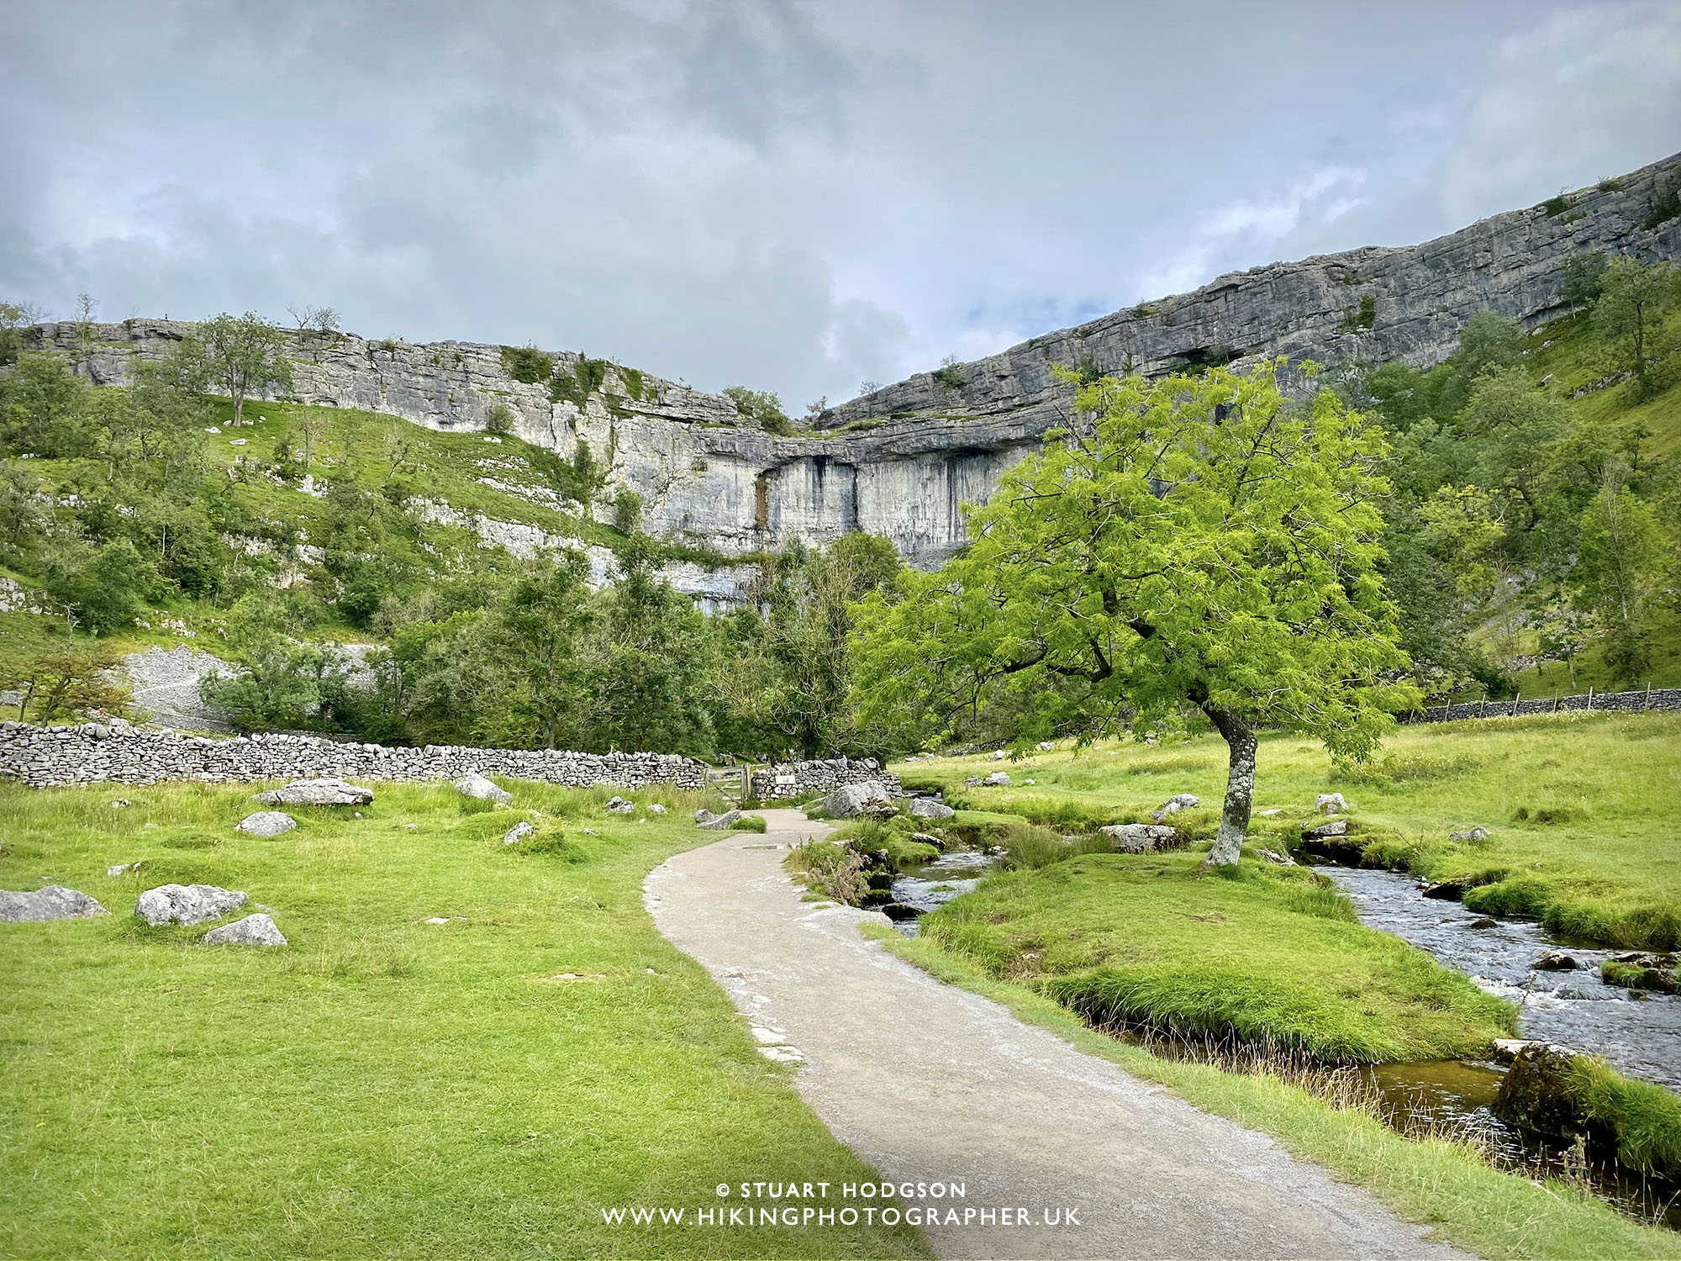
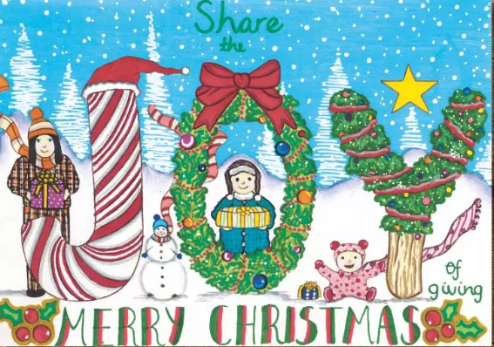

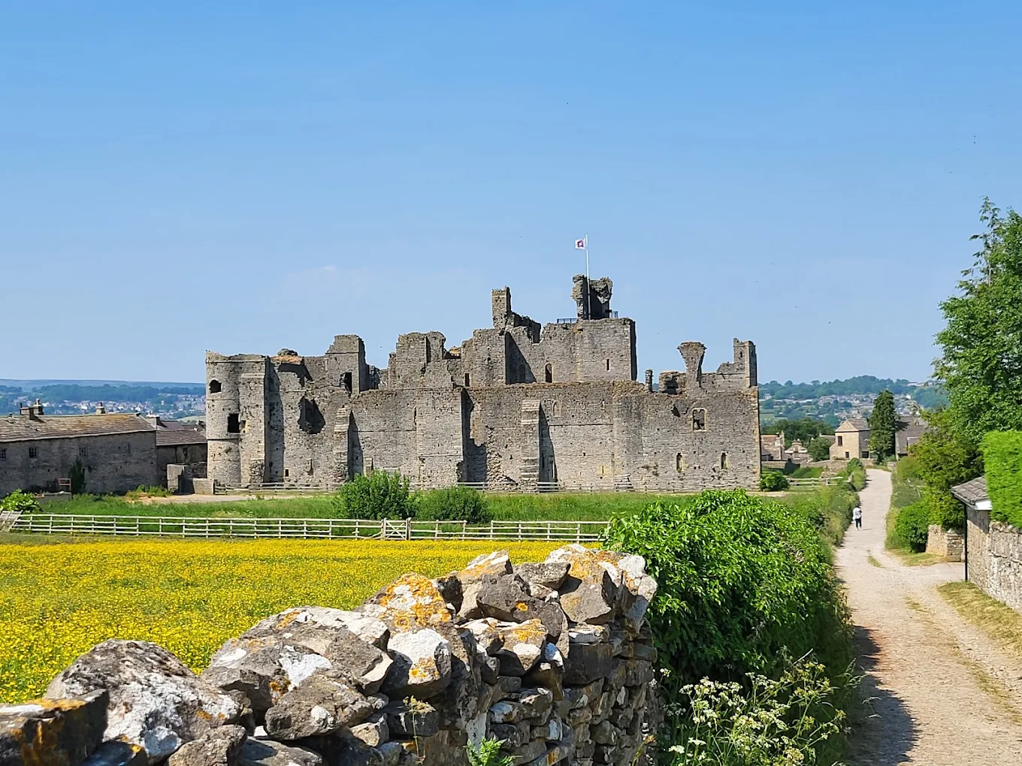
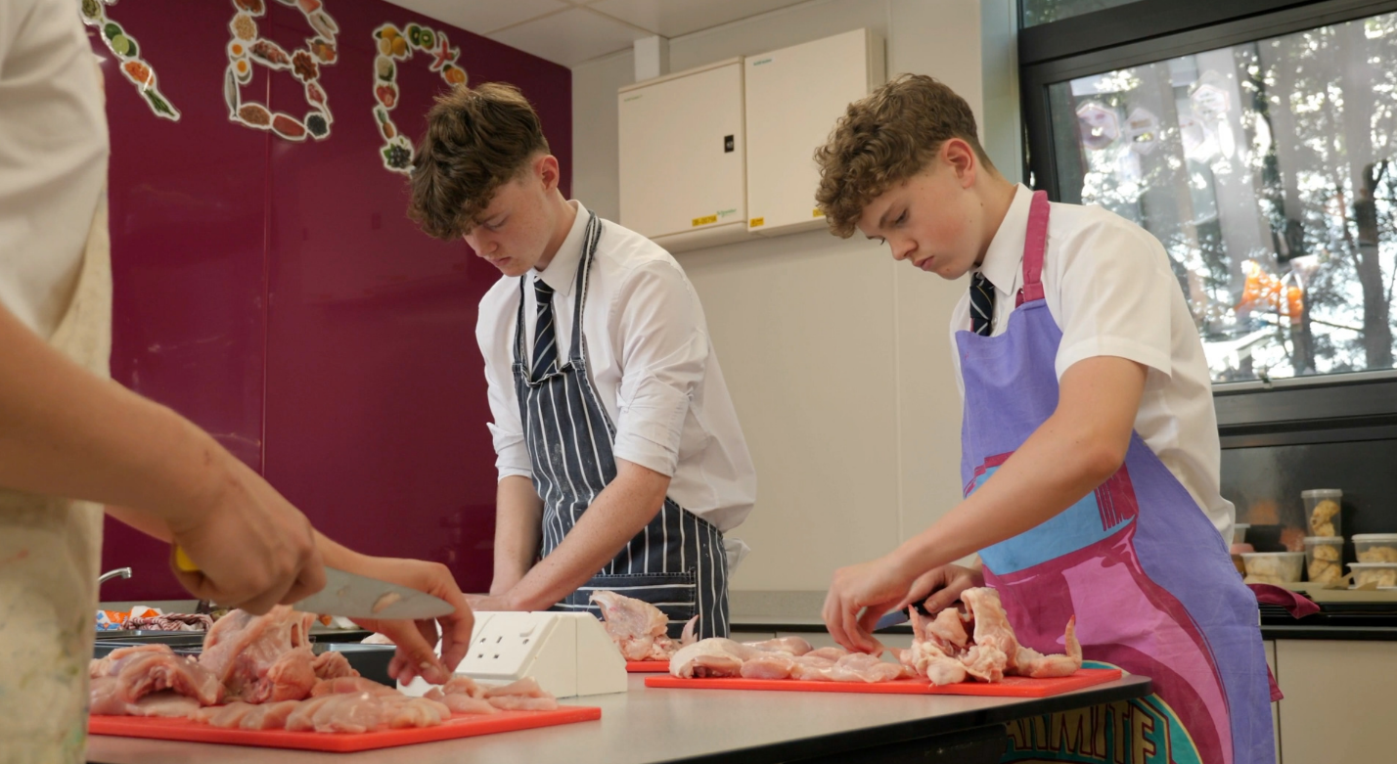

Slide 15
Personal Development
Participate in 1 House event (excluding House singing, House debating and Sports Day) e.g. House drama, MasterChef and various other competitions throughout the year.
Participation in house competitions fosters teamwork, leadership, and a sense of community, while sports activities promote physical health, discipline, and resilience.
You can explore interests, build confidence, and enhance social interactions.
Co-curricular activities – complete 3 personal development activities for 3 months each (at least 2 of these need to be in school either at lunchtime or after school)

Slide 16
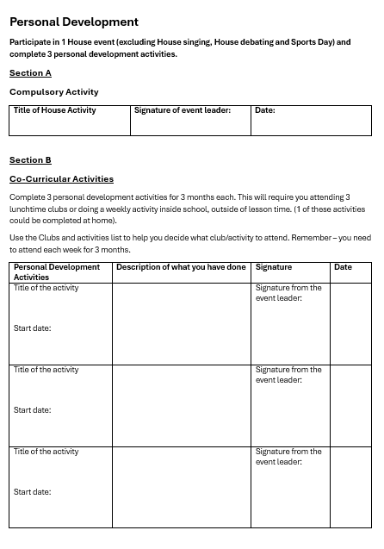

Slide 17


Slide 18
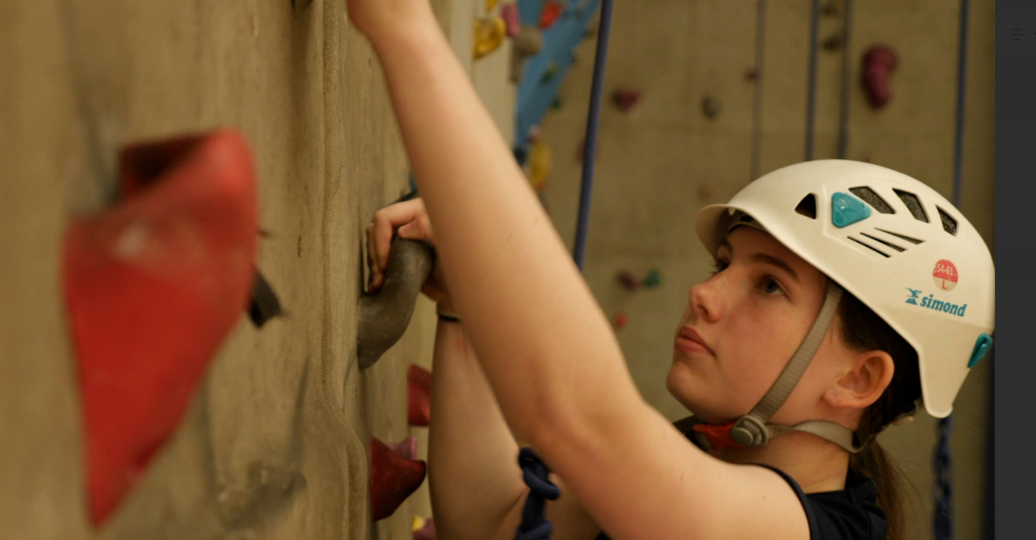

Slide 19
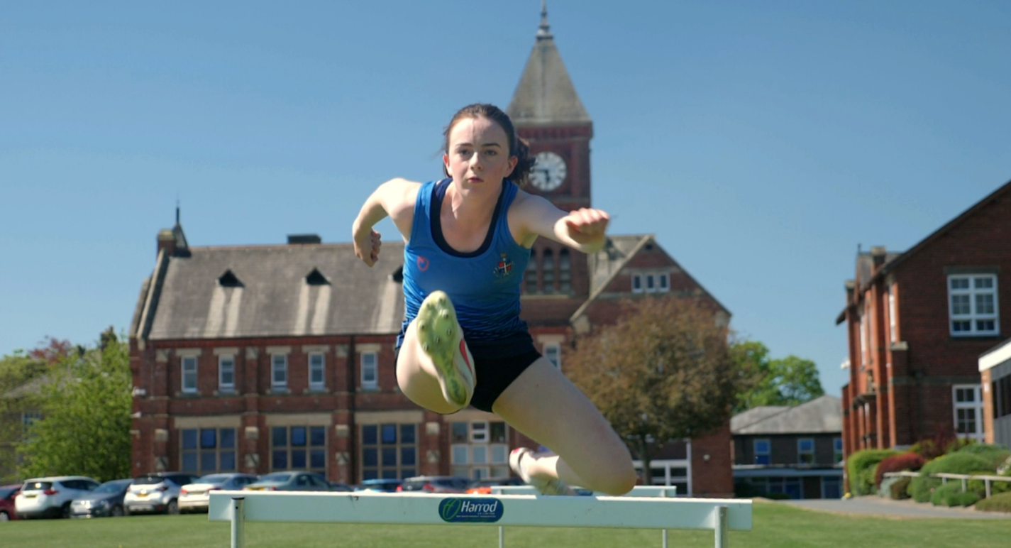

Slide 20
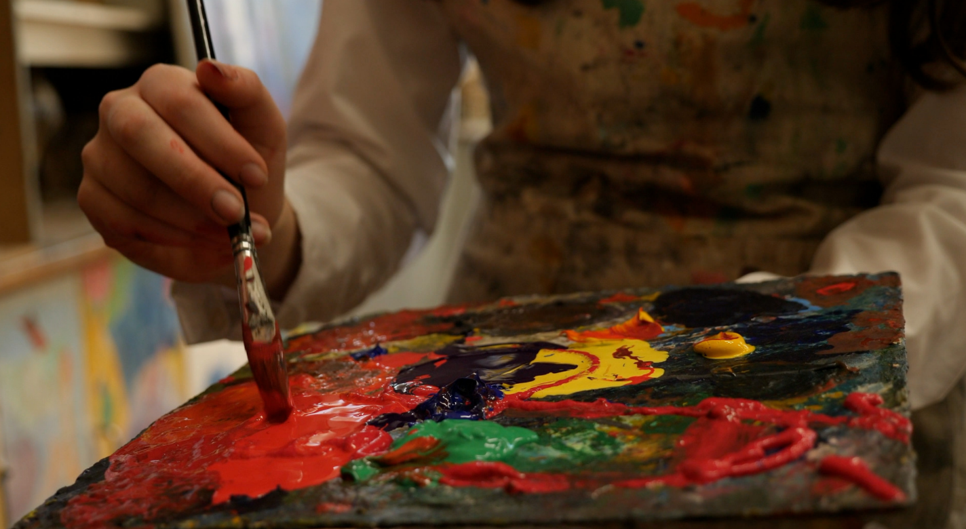

Slide 21
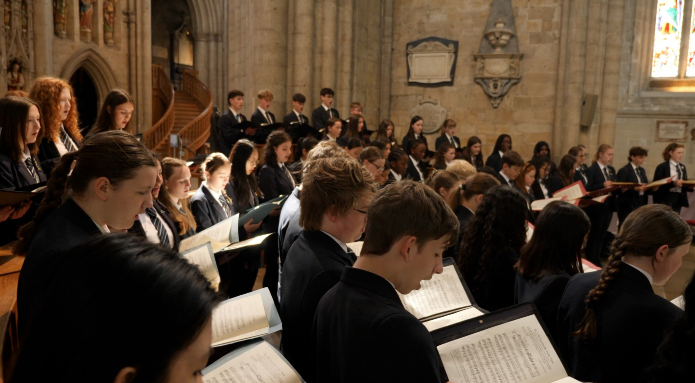

Slide 22
Volunteering and making a difference
Complete 3 hours of volunteering (this could be in school or out of school)
Give your time to help and support others, making a tangible difference in the local community.
Gain confidence, meet diverse individuals and forge new friendships.
You could assist in local events, support charitable causes and offer to help in the local community.

Slide 23
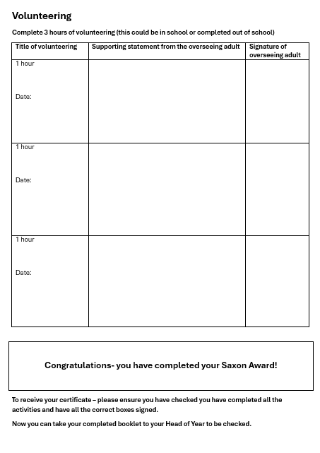

Slide 24
